Slide 1
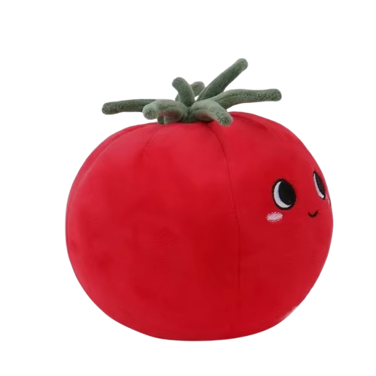

Get Cooked
best group project proposal

Slide 2
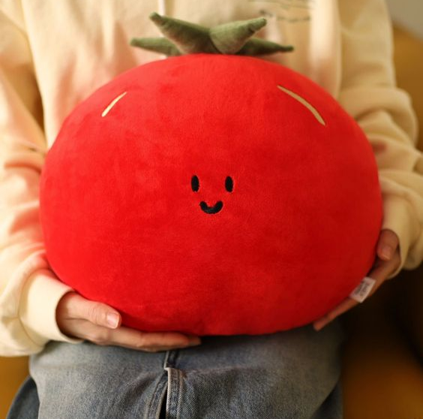
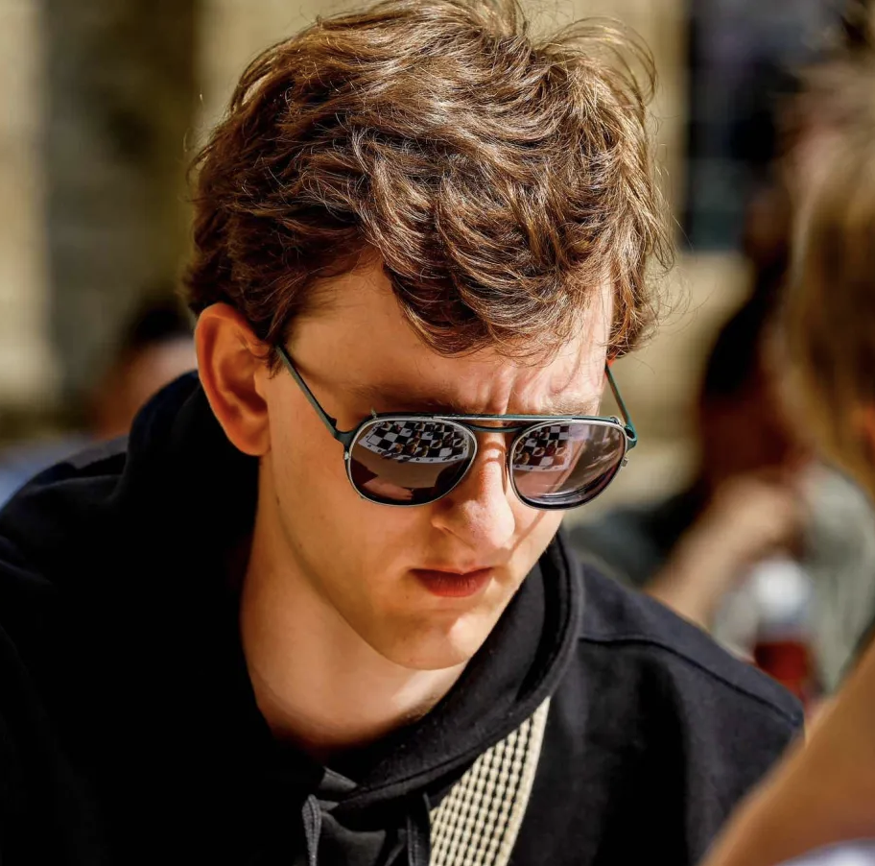
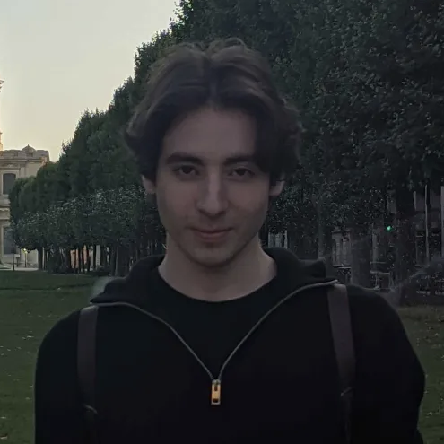
The Prototype Team
Vik
Praet
Adriaan
Musschoot
Yevhenii Ovramenko

Slide 3
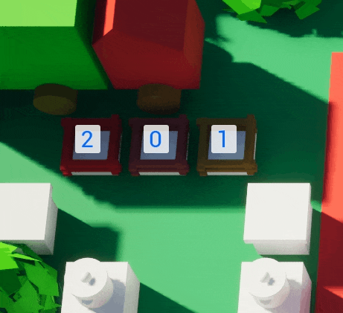
Cooking

Slide 4
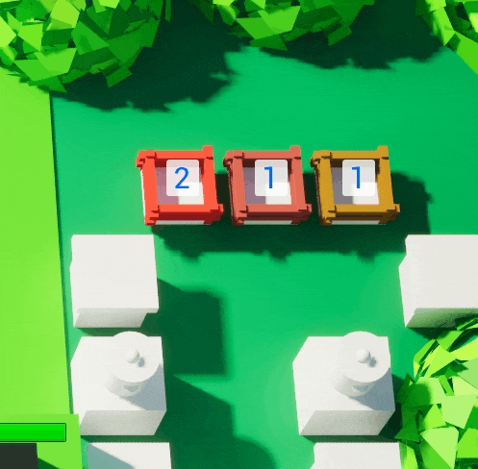
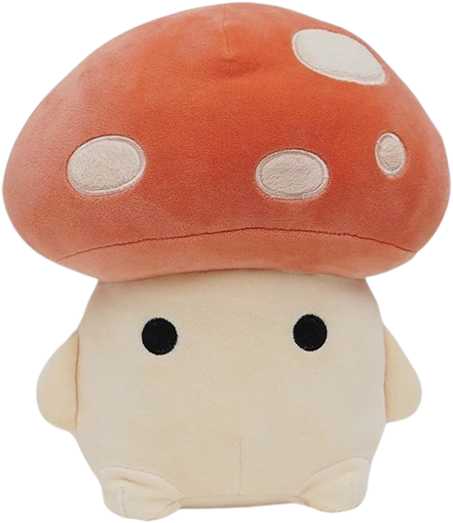
Cooking

Slide 5
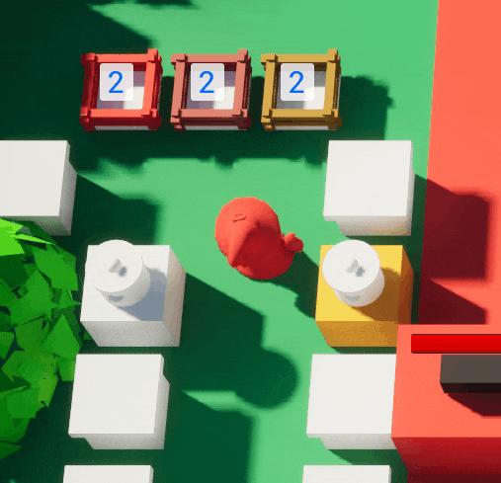
Cooking

Slide 6
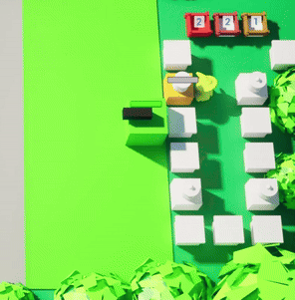

Combat
Throwing

Slide 7
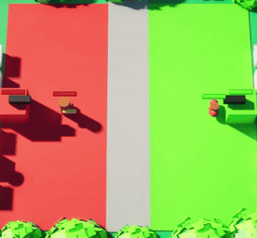
Combat
Throwing
2x Speed

Slide 8
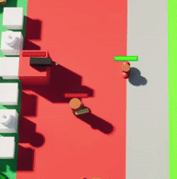

Combat
Throwing
2x Speed

Slide 9
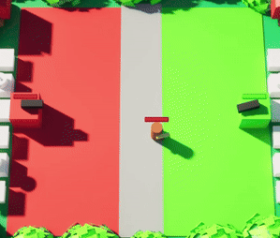
Combat
Throwing
2x Speed, 4x Speed

Slide 10
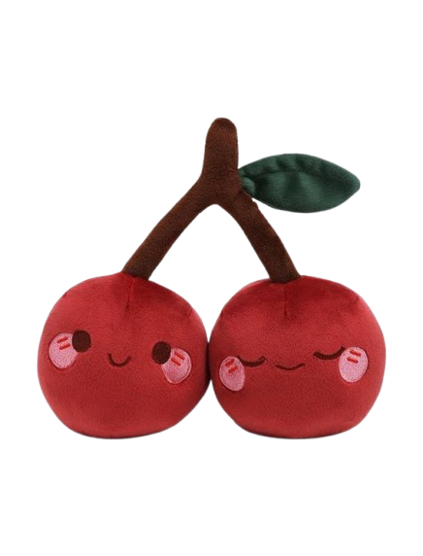
Goals
Throwing
Create a finished releasable game.
Show the excitement of strategic battles with the creativity of cooking.
Release the inner competitive demon in every person
Ruin friendships.
At least Finalists in The Rookies, also to be recognized as Highly Commended.

Slide 11
Gameplay

Slide 12

Q&A

